Slide 1

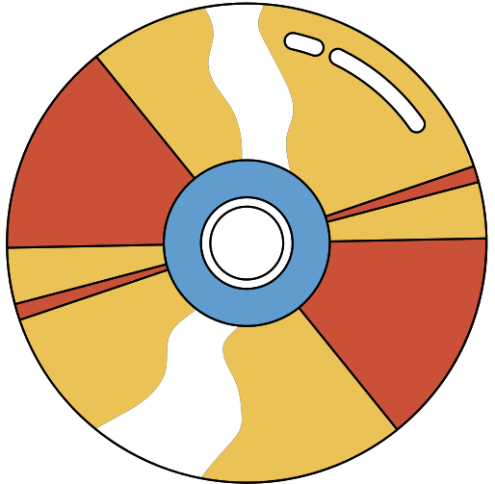



locale
locale
FIND KIDS APP

Slide 2



PROBLEM
As children become more independent and engage in various activities outside the home, there is a growing need for a reliable and efficient solution to track their whereabouts and ensure their well-being. Parents often worry about their children's safety when they are at school, extracurricular activities, or spending time with friends. In such situations, a solution is needed to provide parents with real-time location information and notifications about their child's activities without compromising the child's privacy or security.

Slide 3

SOLUTION
Real-Time Location Tracking: The app allows parents to track their child's location in real-time using GPS technology. Parents can view the child's location on a map and receive periodic updates.
Geofencing: Parents can set up geofences around specific areas, such as school or home. They will receive notifications when their child enters or leaves these predefined zones.
Safe Zones: ChildGuard offers a feature to define safe zones, such as parks or friends' houses, where parents can be assured their child is safe. Any deviation from these zones triggers an alert.
Emergency Alerts: In case of emergencies or unexpected situations, children can send an SOS alert to their parents with their current location, helping parents respond quickly
User Authentication: Only authorized parents or guardians can access the child's location data through secure login credentials, preventing unauthorized access.

Slide 4

UX PROCESS
EMPATHIZE
DEIFNE
IDEATE
PROTOTYPE
research
stakeholder interview
user interview
competitive analysis
brain storming
surveys
persona
user flow
information architecture
Wireframe
ui design
prototype

Slide 5
INTERVIEW QUESTIONS
Have you ever used apps like this one? If so, what were some features that made you dislike those apps?
Do you want to add a feature that also allows the children to track their parents’ movement and location?
Do you want children to be able to track each other? If so would their features differ from those of the parents or would they have different functions?
In the event of the child’s phone going offline or their location getting turned off for more than 12 hours, do you want the app to contact the authorities?
Do you want the app to track other activities of the child, such as the apps they use, the websites they visit, or the messages they send?
How do you want to be notified when your child's location changes, such as through push notifications, SMS, or email?
When was the last time you used such an app?What did you struggle with using in the app? What features did you have trouble finding?

Slide 6
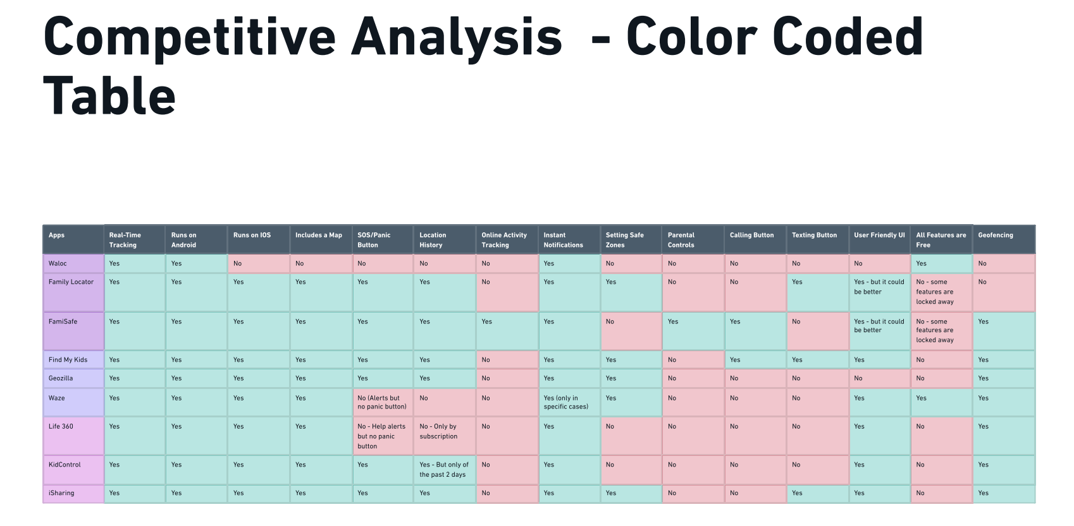
COMPETITIVE ANALYSIS

Slide 7
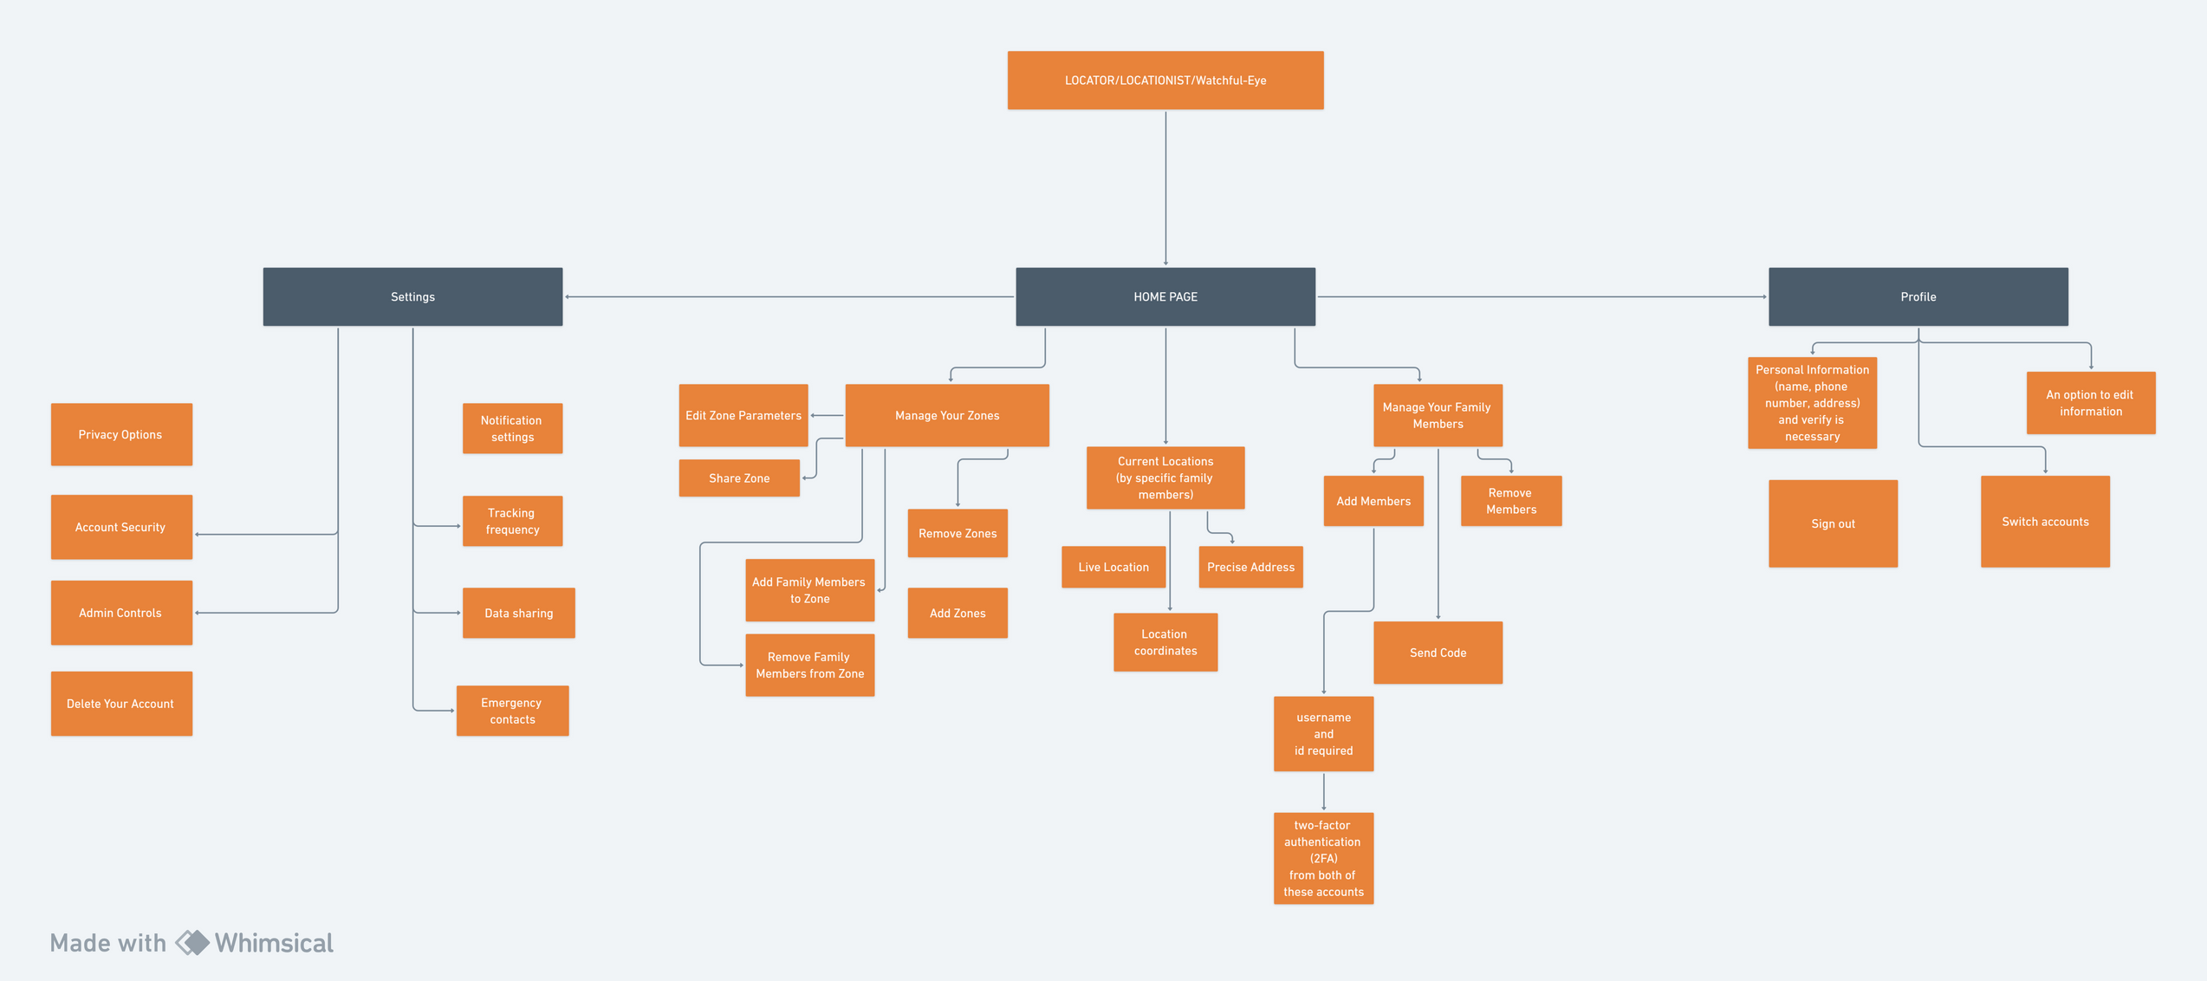

INFORMATION ARCHIRECTURE

Slide 8

COLOURS
#F16400
#FF7C7C
#FF4E36
#FFFFFF
#000000
#FF885F

Slide 9
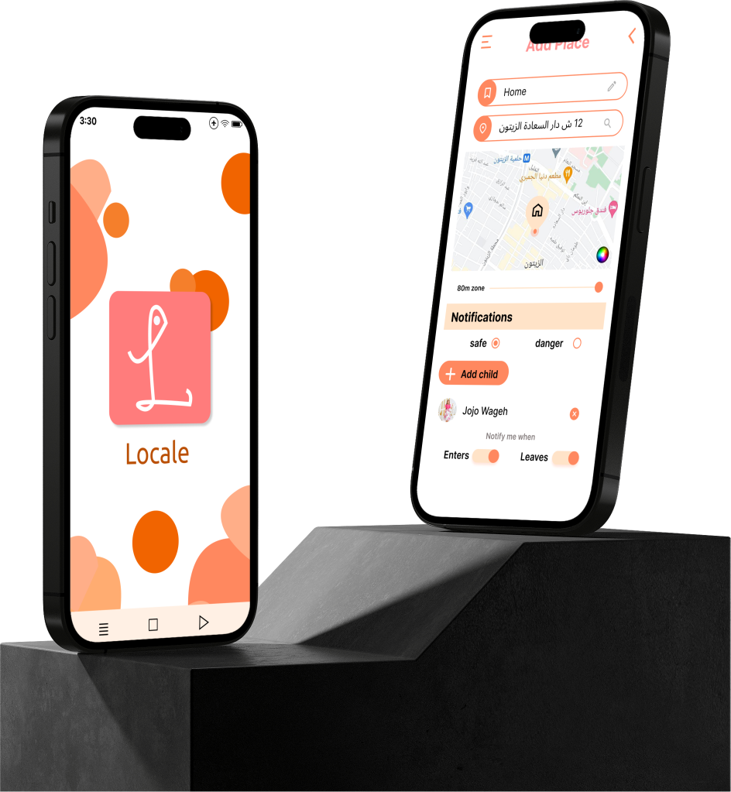
UI DESIGN

Slide 10
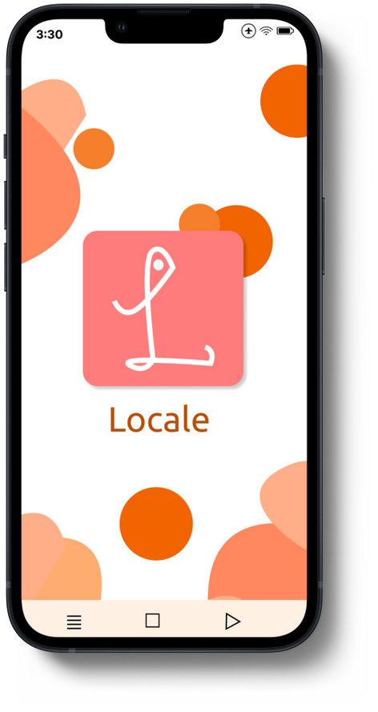
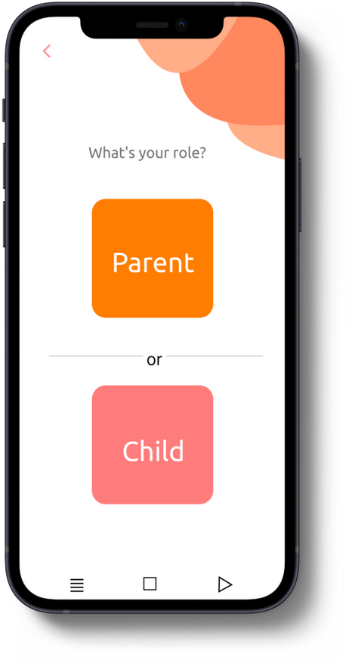
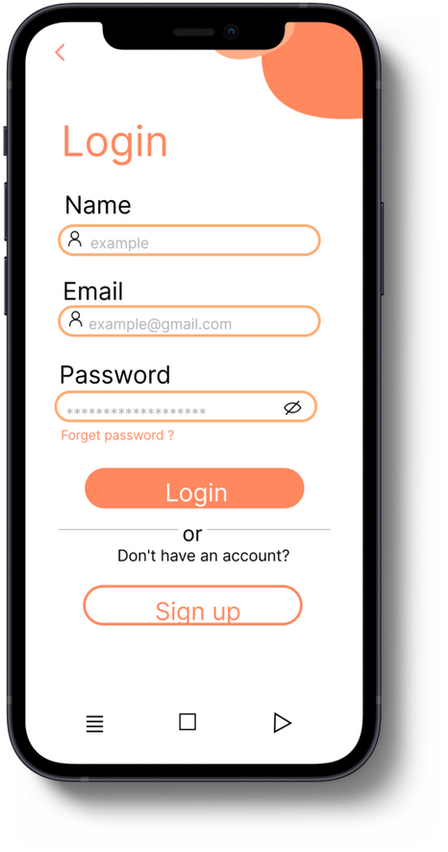
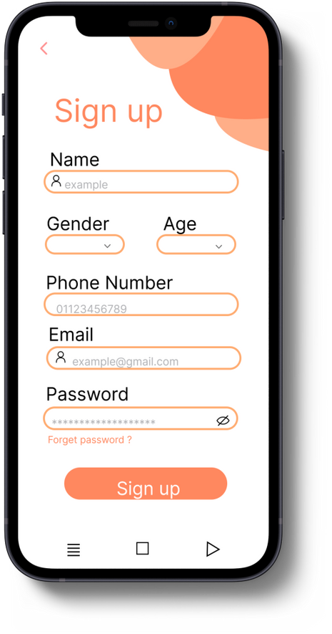
UI DESIGN

Slide 11
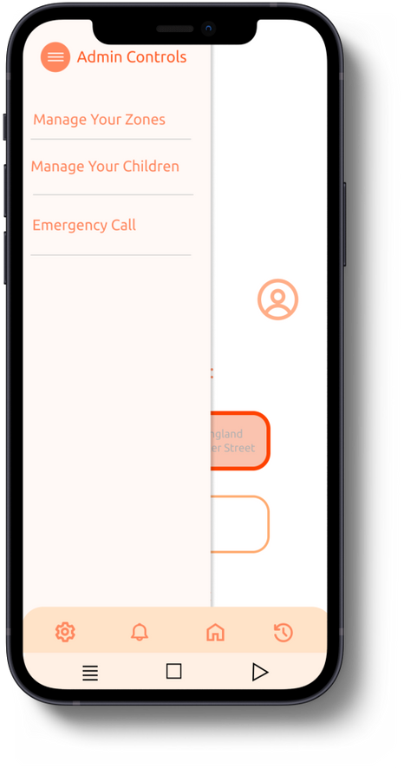
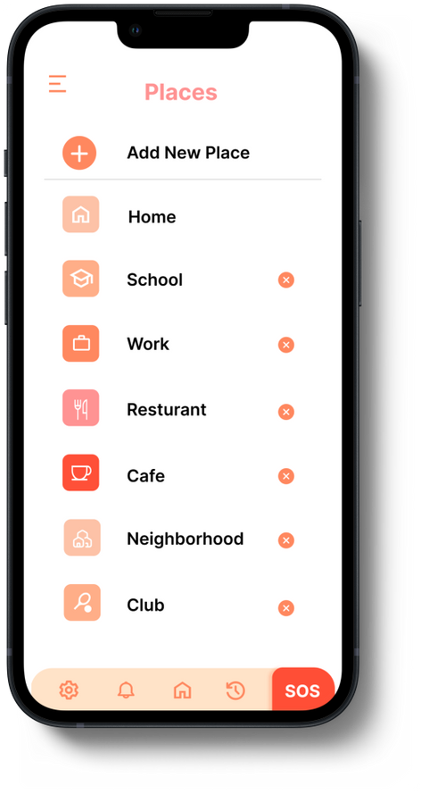
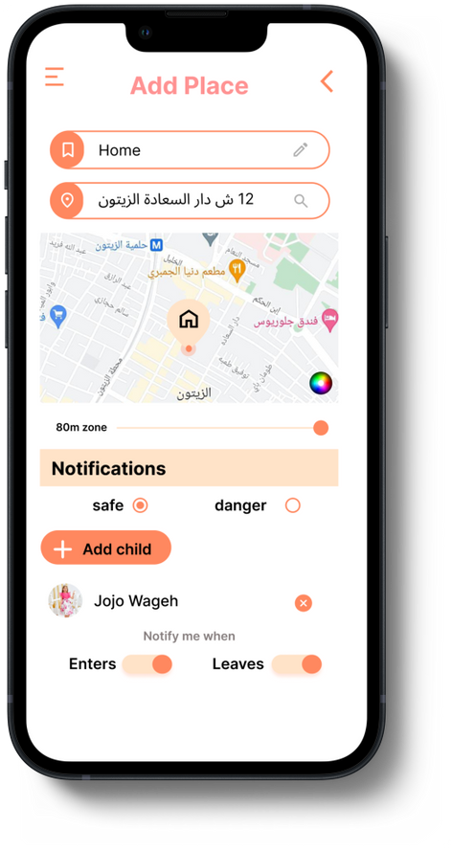
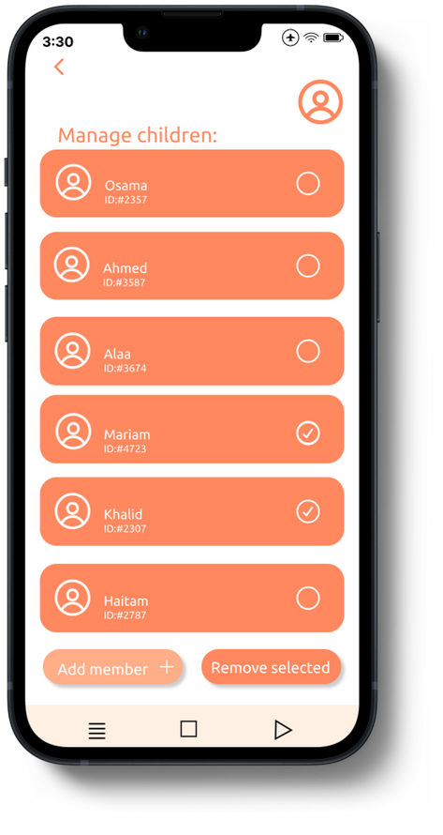
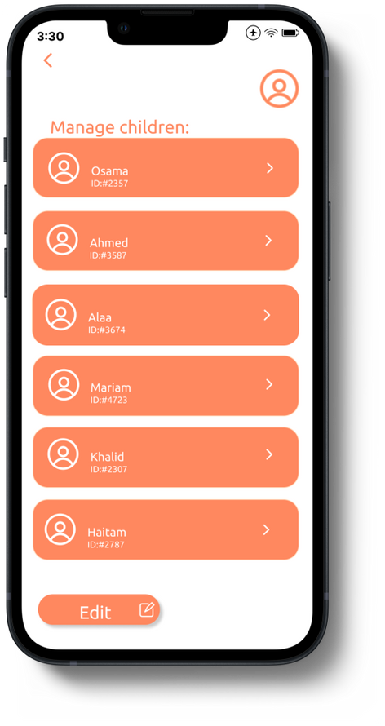
UI DESIGN

Slide 12
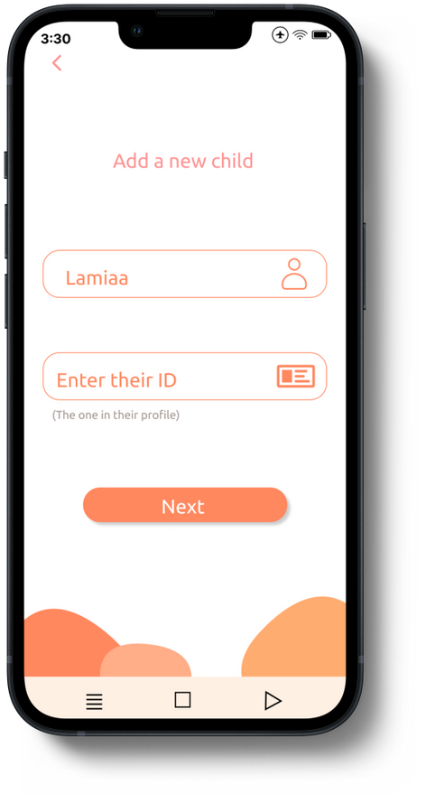
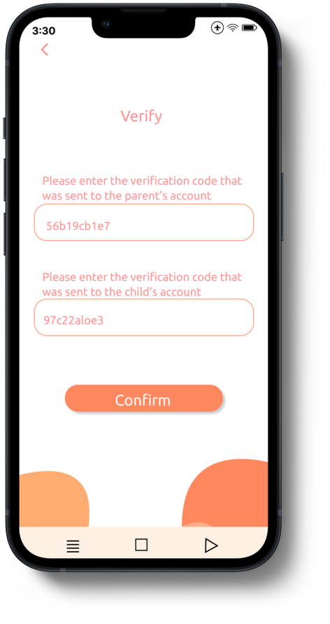
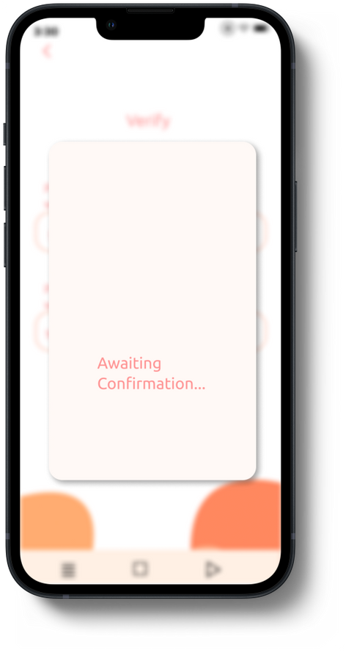
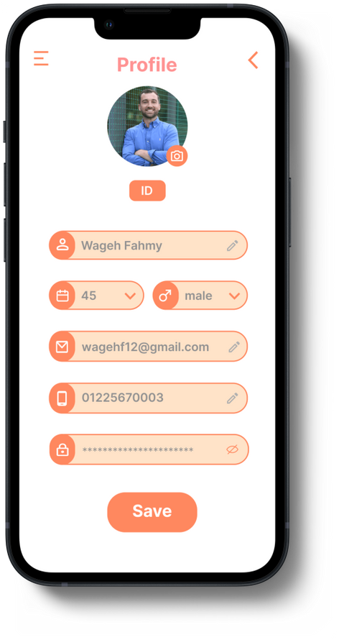
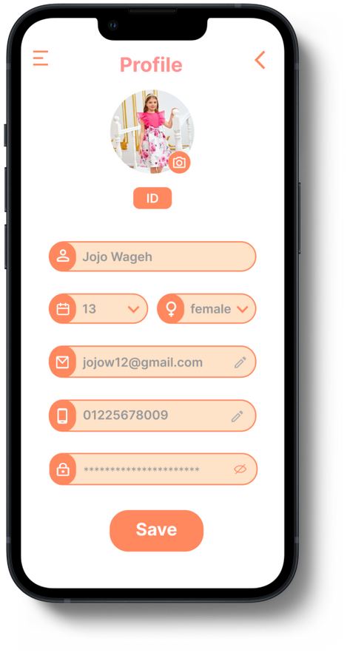
UI DESIGN

Slide 13
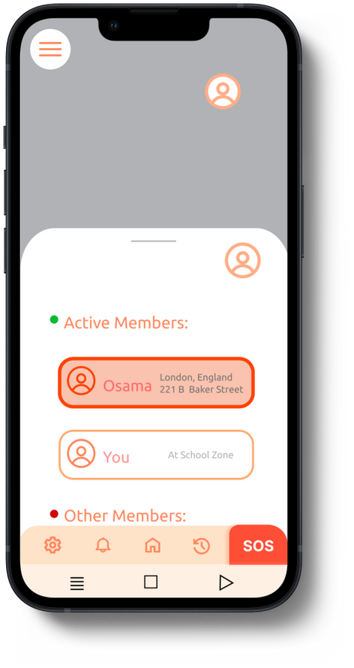
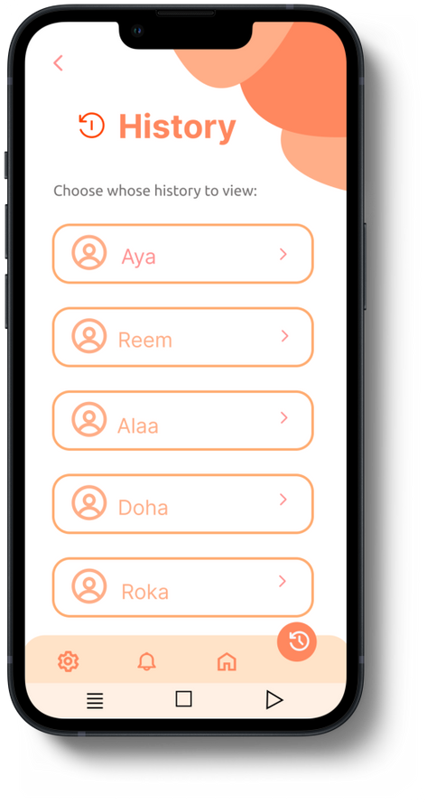
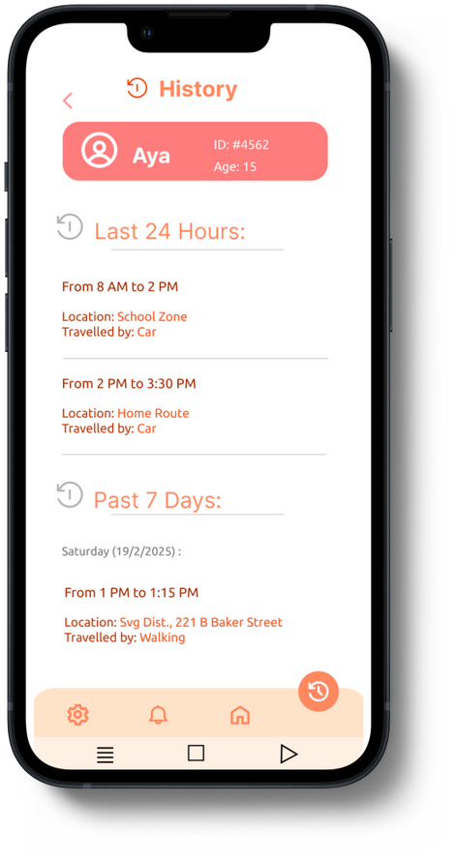
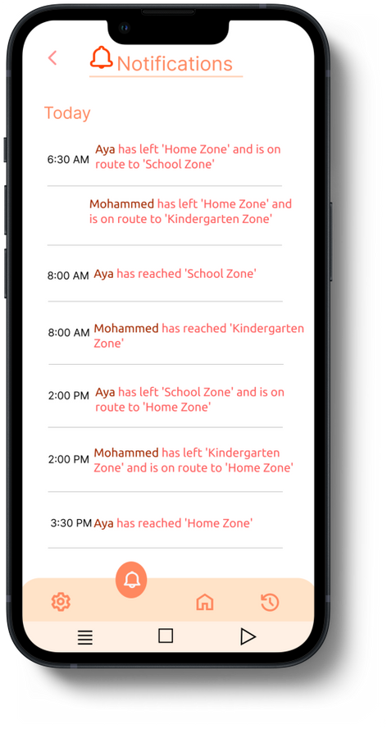
UI DESIGN

Slide 14
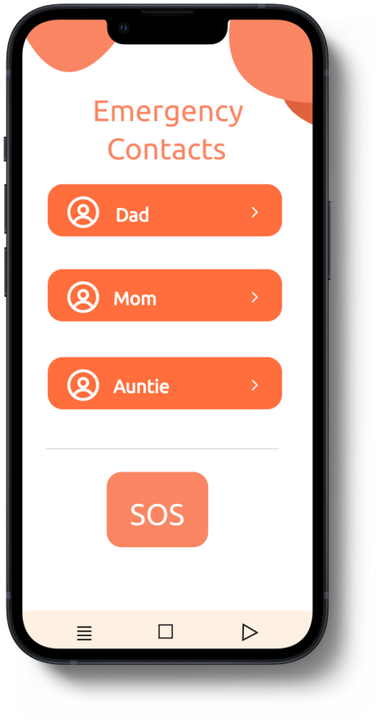
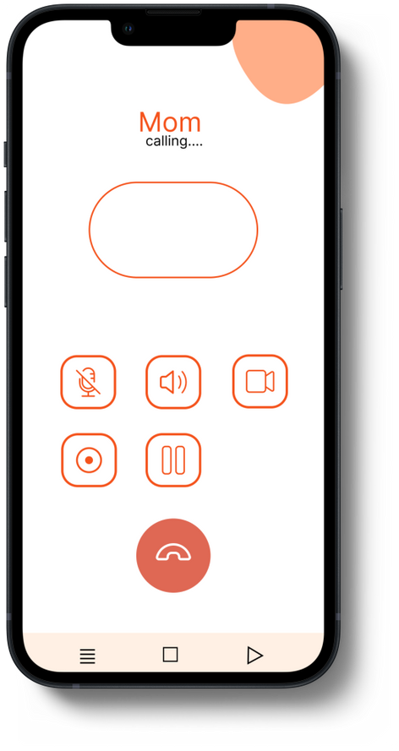
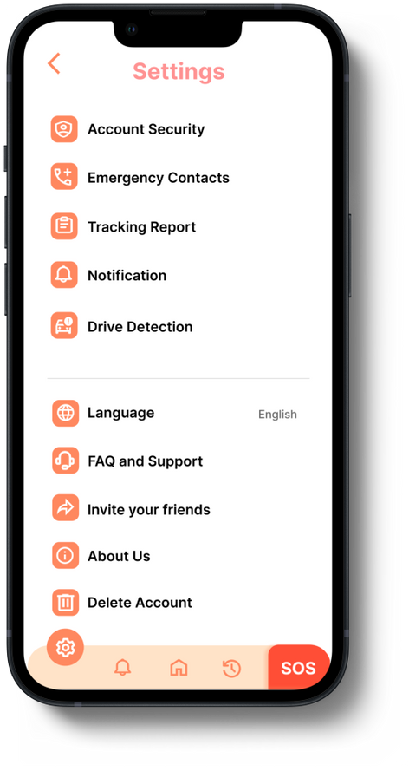
UI DESIGN

Slide 15

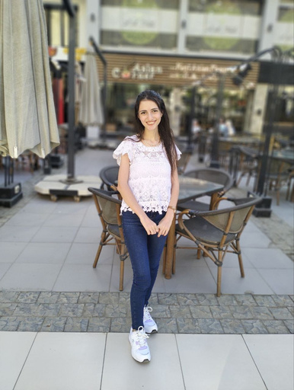


MEMBRS
NESMA
VERENA
JANA
ABDALLAH

Slide 16


THANK YOU

